Slide 1
Road Trip to Spain
Paolo Giuseppe Faso

Slide 2
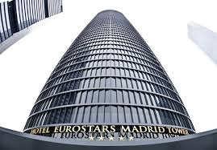
Transportation and Such
I plan to ride First Class on British airways to Madrid.
The plane ride will cost around $1,400…..
Once in Madrid I will take residency in the Eurostar Madrid Tower hotel.
A junior suite for 14 days cost $3,670.27…..

Slide 3
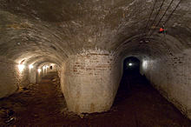
Days 1-2 Museo de Historia de Barcelona
I can start my trip by heading to Barcelona City History Museum. It is essentially a city museum that conserves and communicates historical heritage of Barcelona from it’s origins in Roman Time until present day. The museum is spread all around the city displaying ancient remains, from roman time, medieval time, and contemporary time.

Slide 4
Days 3-4 Museo del Prado
The Museo del Prado is the main Spanish art museum located in central Madrid. Founded in 1819, this museum contains the works of Francisco de Goya, Diego Velazquez, El Greco, and Titan. The museum has 7,600 paintings, 1,000 sculptures, 4,800 prints and 8,200 drawings.

Slide 5
Days 5-6 Catedral de Santa Mary de le sede
The Cathedral of Saint Mary of the see is a Roman Catholic cathedral It was completed in the early 16th century, and It is the largest cathedral in the world. The cathedral was built to essentially demonstrate the cities wealth after it became a major trading center in the years following the Reconquista.

Slide 6
Days 7-8 Palacio Real de Madrid
The Royal Palace of Madrid is the official residence of the Spanish Royal Family in the city of Madrid. However King Felipe VI and the Royal Family do not reside in the palace due to the fact that the palace is only used for state ceremonies.

Slide 7
Days 9-10 Playa de Ses llletes
Playa de Ses llletes is a beach located on the island of Formentera. Whats significant and different about the beaches on Formentera is that there are no huge buildings or structures to ruin the beauty of nauture

Slide 8
Days 11-12 The Running of the Bulls
The running of the bulls is a practice that involves running in front of a group of typically six bulls. Spanish tradition says the origin of this event began during the early 14thcentury. While transporting cattle in order to be sold, men would try to speed the process by rushing the cattle through fear and excitement.

Slide 9
Days 13-14 Hala Madrid
Real Madrid is a professional football club and was founded in 1902. The Soccer club is the most valuable sports team in the world, worth 2.5 billion euros, with an annual revenue of 549.5 euros. The team is arguably the most successful team in soccer history with 10 EUFA Champions league titles, and 32 la liga titles.

Slide 11
Conclusion
This project was an interesting and creative way for me to learn more about Spain and it’s rich cultural. However I probably wouldn’t go on my road trip in real life any time soon due to the fact that my trip will cost around $5,500.

